Slide 1
22CS2403 Database Management System
Dr. Meenakshi Malhotra
Associate Professor
Department of Computer Science and Engineering
Dayananda Sagar University, Harohalli, Karnataka.

Slide 2
UNIT – V 07 Hours
TRANSACTION MANAGEMENT
The ACID Properties; Transactions and Schedules; Concurrent Execution of Transactions; Concurrency Control Mechanisms; Error recovery methods.
(Text Book-1: Chapter 20: 20.1 to 20.5, Chapter 21: 21.1 to 21.3, Chapter 22: 22.1 to 22.4)
Reference Book 1: Chapter 16.1, 1.2, 16.3,

Slide 3
Introduction to Transaction Processing Concepts and Theory

Slide 4
Introduction
Transaction
Describes the local unit of database processing
Transaction processing systems
Systems with large databases and hundreds of concurrent users
Require high availability and fast response time

Slide 5
Introduction
Transaction
A transaction is a logical unit of work that consists of one or more database operations.
These operations can include read, write, update, and deletion.
A transaction is considered to be an indivisible and atomic operation, meaning that it must be executed in its entirety or not at all.
To ensure the consistency and reliability of the database, transactions go through several states during their execution.

Slide 6
Introduction
Transaction
They are logically linked operations that access a shared database
Examples include:
ATM operations: Withdraw money, Check balance.
Airlines operations: Buy an airline ticket, flight scheduling, web checking
Online purchase : select an item from catalog -> check availability-> order amount->provide payment details->payment-> track order-> issue order-> dispatch-> Issue cancelation/return

Slide 7
20.1 Introduction to Transaction Processing
Single-user DBMS
At most one user at a time can use the system
Example: home computer
Multiuser DBMS
Many users can access the system (database) concurrently
Example: airline reservations system

Slide 8
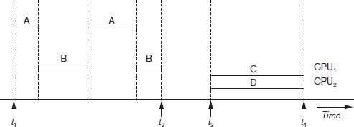
Introduction to Transaction Processing (cont’d.)
Multiprogramming
Allows the operating system to execute multiple processes concurrently
Executes commands from one process, then suspends that process and executes commands from another process, etc.
Interleaved processing
Parallel processing
Processes C and D in the figure
Interleaved processing versus parallel processing of concurrent transactions

Slide 9
Transactions
Transaction: an executing program
Forms logical unit of database processing
Begin and end transaction statements
Specify transaction boundaries
Read-only transaction → If the database operations in a transaction do not update the database but only retrieve data
Read-write transaction

Slide 10
Database Items
Database represented as collection of named data items
Size of a data item called its granularity
Data item
Record
Disk block
Attribute value of a record
Transaction processing concepts independent of item granularity

Slide 11
Read and Write Operations
read_item(X)
Reads a database item named X into a program variable named X
Process includes finding the address of the disk block, and copying to and from a memory buffer
write_item(X)
Writes the value of program variable X into the database item named X
Process includes finding the address of the disk block, copying to and from a memory buffer, and storing the updated disk block back to disk

Slide 12
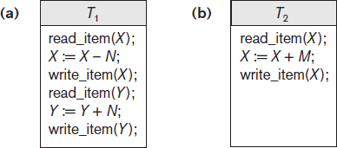
Read and Write Operations (cont’d.)
Read set of a transaction
Set of all items read
Write set of a transaction
Set of all items written
Two sample transactions (a) Transaction T1 (b) Transaction T2

Slide 13
Why Concurrency Control Is Needed
Several problems can occur when concurrent transactions execute in an uncontrolled manner.
The lost update problem
The Temporary Update (or Dirty Read) Problem.
The Incorrect Summary Problem.
The Unrepeatable Read Problem

Slide 14
Concurrency Control
Transactions submitted by various users may execute concurrently
Access and update the same database items
Some form of concurrency control is needed
The lost update problem
Occurs when two transactions that access the same database items have operations interleaved
Results in incorrect value of some database items

Slide 15
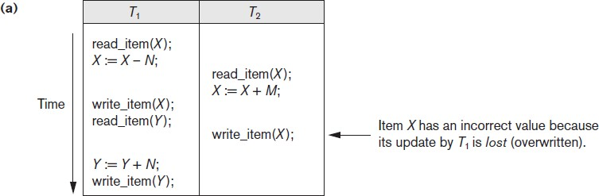

The Lost Update Problem
Some problems that occur when concurrent execution is uncontrolled (a) The lost update problem

Slide 16
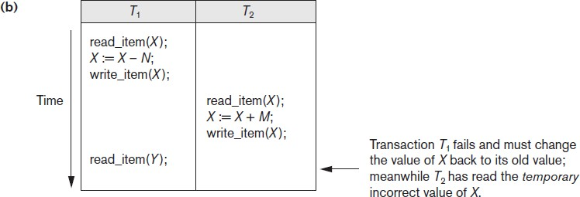








The Temporary Update or Dirty Read Problem
Some problems that occur when concurrent execution is uncontrolled (b) The temporary update problem

Slide 17
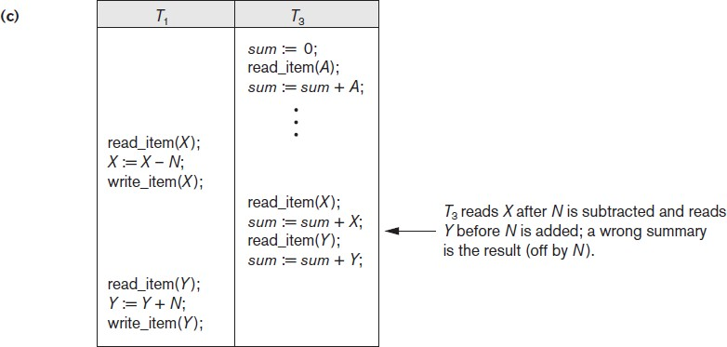






The Incorrect Summary Problem
Some problems that occur when concurrent execution is uncontrolled (c) The incorrect summary problem

Slide 18
The Unrepeatable Read Problem
Transaction T reads the same item twice
Value is changed by another transaction T′ between the two reads
T receives different values for the two reads of the same item
T2
Read(X)
Read(Y)
Y;Y+10
Write(Y)
Read(X)
T1
Read(X
X;X+10
Write(X)

Slide 19
Why Recovery is Needed
Committed transaction
Effect recorded permanently in the database
Aborted transaction
Does not affect the database

Slide 20
Why Recovery is Needed
Types of transaction failures
Computer failure (system crash)
Transaction or system error➔ Some operation in the transaction may cause it to fail, such as integer overflow or division by zero
Local errors or exception conditions detected by the transaction➔ logical errors : certain conditions may occur that necessitate cancellation of the transaction.
Concurrency control enforcement ➔ The concurrency control method may abort a transaction because it violates serializability
Disk failure.
Physical problems and catastrophes.
System must keep sufficient information to recover quickly from the failure
Disk failure or other catastrophes have long recovery times

Slide 21
Transaction and System Concepts
System must keep track of when each transaction starts, terminates, commits, and/or aborts:
BEGIN_TRANSACTION
This marks the beginning of transaction execution
READ or WRITE
END_TRANSACTION
COMMIT_TRANSACTION
This signals a successful end of the transaction so that any changes (updates) executed by the transaction can be safely committed to the database and will not be undone.
ROLLBACK (or ABORT)
This signals that the transaction has ended unsuccessfully, so that any changes or effects that the transaction may have applied to the database must be undone.

Slide 22
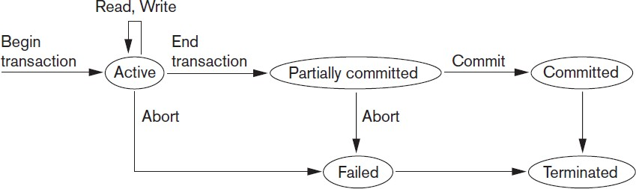
Transaction and System Concepts (cont’d.)
some types of concurrency control protocols may do additional checks to see if the transaction can be committed or not.
Also, some recovery protocols need to ensure that a system failure will not result in an inability to record the changes of the transaction permanently
The terminated state corresponds
to the transaction leaving the system.
State transition diagram illustrating the states for transaction execution

Slide 23
The System Log
System log keeps track of transaction operations
Sequential, append-only file kept on disk
Not affected by failure (except disk or catastrophic failure)
Log buffer
Main memory buffer
When full, appended to the end of the log file on disk
Log file is backed up periodically
Undo and redo operations based on the log possible

Slide 24
The System Log
1. [start_transaction, T]. Indicates that transaction T has started execution.
2. [write_item, T, X, old_value, new_value]. Indicates that transaction T has changed the value of database item X from old_value to new_value.
3. [read_item, T, X]. Indicates that transaction T has read the value of database item X.
4. [commit, T]. Indicates that transaction T has completed successfully, and affirms that its effect can be committed (recorded permanently) to the database.
5. [abort, T]. Indicates that transaction T has been aborted.

Slide 25
Commit Point of a Transaction
Occurs when all operations that access the database have completed successfully
And effect of operations recorded in the log
Transaction writes a commit record into the log
If system failure occurs, can search for transactions with recorded start_transaction but no commit record
Force-writing the log buffer to disk
Writing log buffer to disk before the transaction reaches commit point

Slide 26
DBMS-Specific Buffer Replacement Policies
Page replacement policy
Selects particular buffers to be replaced when all are full
Domain separation (DS) method
Each domain handles one type of disk pages
Index pages
Data file pages
Log file pages
The number of available buffers for each domain is predetermined
Page replacements within each domain are handled via the basic LRU (least recently used) page replacement

Slide 27
DBMS Buffers
DBMS will maintain several main memory data buffers in the database cache
When buffers are occupied, a buffer replacement policy is used to choose which buffer will be replaced
Example policy: least recently used

Slide 28
DBMS-Specific Buffer Replacement Policies (cont’d.)
Hot set method
Useful in queries that scan a set of pages repeatedly eg: in Joins
Does not replace the set in the buffers until processing is completed
The DBMIN method
Predetermines the pattern of page references for each algorithm for a particular type of database operation
Calculates locality set using query locality set model (QLSM)

Slide 29
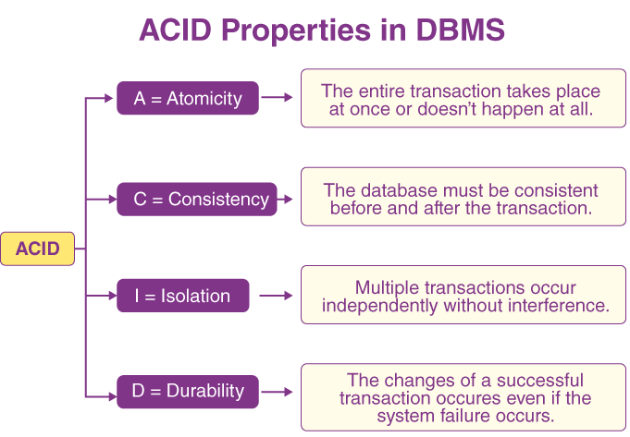
20.3 Desirable Properties of Transactions

Slide 30
20.3 Desirable Properties of Transactions
ACID properties
Atomicity
Transaction performed in its entirety or not at all
Consistency preservation
Takes database from one consistent state to another
Isolation
Not interfered with by other transactions
Durability or permanency
Changes must persist in the database

Slide 31
Atomicity and Durability
A DBMS must find a way to remove the effects of partial transactions from the database➔ it must ensure transaction atomicity:
Either all of a transaction's actions are carried out or none are.
A DBMS ensures transaction atomicity by undoing the actions of incomplete transactions.
To be able to do this, the DBMS maintains a record, called the log of all writes to the database.
The log is also used to ensure durability: If the system crashes before the changes made by a completed transaction are written to disk, the log is used to remember and restore these changes when the system restarts.
Notes:
31

Slide 32
Atomicity and Durability
Recovery Manager: The DBMS component that ensures atomicity and durability,
A transaction is defined as anyone execution of a user program in a DBMS and differs from an execution of a program outside the DBMS in important ways.
Executing the same program several times generates several transactions.
How the DBMS handles concurrent executions is an important aspect of transaction management and the subject of concurrency control.
The DBMS ensures that the changes made by such partial transactions are not seen by other transactions. How this is achieved is the subject of crash recovery
Notes:
32

Slide 33
Consistency and Isolation
Users are responsible for ensuring transaction consistency.
➔That is, the user who submits a transaction must ensure that, when run to completion by itself against a 'consistent' database instance, the transaction will leave the database in a 'consistent' state.
The isolation property is ensured by guaranteeing that,
➔ even though actions of several transactions might be interleaved, the net effect is identical to executing all transactions one after the other in some serial order.
Slide 10- 33
Notes:
33

Slide 34
Desirable Properties of Transactions (cont’d.)
Levels of isolation
Level 0 isolation does not overwrite the dirty reads (reading uncommitted data) of higher-level transactions
Level 1 isolation has no lost updates
Level 2 isolation has no lost updates and no dirty reads
Level 3 (true) isolation has repeatable reads
In addition to level 2 properties
Snapshot isolation
all reads made in a transaction will see a consistent snapshot of the database

Slide 35
Characterizing Schedules Based on Recoverability
Schedule or history
Order of execution of operations from all transactions
Operations from different transactions can be interleaved in the schedule
Total ordering of operations in a schedule
For any two operations in the schedule, one must occur before the other

Slide 36
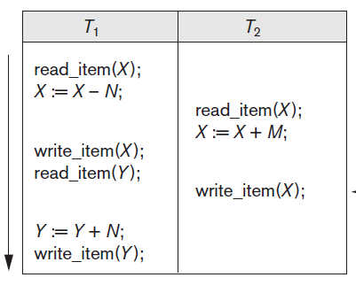
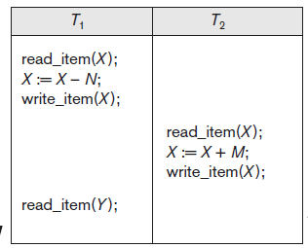
Characterizing Schedules Based on Recoverability Conflicting Operations in a Schedule.
Sb: r1(X); w1(X); r2(X); w2(X); r1(Y); a1;
Sa: r1(X); r2(X); w1(X); r1(Y); w2(X); w1(Y);
r1(X); w2(X) to w2(X); r1(X),

Slide 37
Characterizing Schedules Based on Recoverability Conflicting Operations in a Schedule.
Two conflicting operations in a schedule
Operations belong to different transactions
Operations access the same item X
At least one of the operations is a write_item(X)
Two operations conflict if changing their order results in a different outcome
Read-write conflict (unrepeatable reards)
Write-write conflict (Overwriting Uncommitted Data)

Slide 38
Characterizing Schedules Based on Recoverability Conflicting Operations in a Schedule.
A schedule S of n transactions T1, T2, … , Tn is said to be a complete schedule if the following conditions hold:
The operations in S are exactly those operations in T1, T2, … , Tn, including a commit or abort operation as the last operation for each transaction in the schedule.
For any pair of operations from the same transaction Ti, their relative order of appearance in S is the same as their order of appearance in Ti.
For any two conflicting operations, one of the two must occur before the other in the schedule.

Slide 39
Characterizing Schedules Based on Recoverability (cont’d.)
Recoverable schedules
Recovery is possible
Nonrecoverable schedules should not be permitted by the DBMS
No committed transaction ever needs to be rolled back
Cascading rollback may occur in some recoverable schedules
Uncommitted transactions may need to be rolled back

Slide 40
Characterizing Schedules Based on Recoverability (cont’d.)
Recoverable schedules
The condition for a recoverable schedule is as follows:
A schedule S is recoverable if no transaction T in S commits until all transactions T′ that have written some item X that T reads have committed.
A transaction T reads from transaction T′ in a schedule S if some item X is first written by T′ and later read by T.
In addition, T′ should not have been aborted before T reads item X, and there should be no transactions that write X after T′ writes it and before T reads it

Slide 41
Characterizing Schedules Based on Recoverability (cont’d.)
For the schedule to be recoverable, the
c2 operation in Sc must be postponed until after T1 commits, as shown in Sd.
Recoverable schedules
However, consider the two (partial) schedules Sc and Sd that follow:
Sc: r1(X); w1(X); r2(X); r1(Y); w2(X); c2; a1;
Sd: r1(X); w1(X); r2(X); r1(Y); w2(X); w1(Y); c1; c2;
Se: r1(X); w1(X); r2(X); r1(Y); w2(X); w1(Y); a1; a2;
T1-> read and write X
T2→ read X
T1-> write X
T2 commits and T1 aborts
➔Sc is not recoverable because T2 reads item X from T1, but T2 commits before T1 commits.
The problem occurs if T1 aborts after the c2 operation in Sc.
If T1 aborts instead of committing, then T2 should also abort as shown in Se,

Slide 42
Characterizing Schedules Based on Recoverability (cont’d.)
Cascadeless schedule
Avoids cascading rollback
every transaction in the schedule reads only items that were written by committed transactions
Strict schedule
Transactions can neither read nor write an item X until the last transaction that wrote X has committed or aborted
Simpler recovery process
Restore the before image

Slide 43
Characterizing Schedules Based on Serializability
Serializable schedules
Always considered to be correct when concurrent transactions are executing
Places simultaneous transactions in series
Transaction T₁ before T₂, or vice versa
in a serial schedule,
only one transaction at a time is active
the commit (or abort) of the active transaction initiates execution of the next transaction

Slide 44
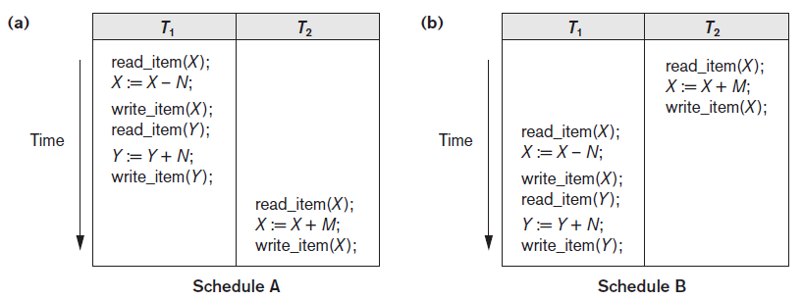
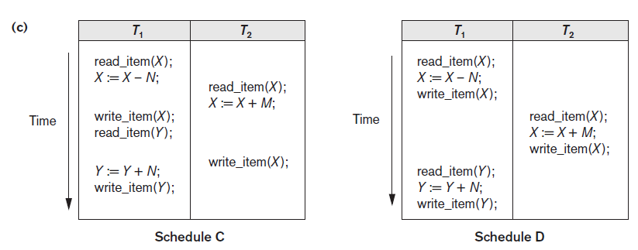
Examples of serial and nonserial schedules involving transactions T1 and T2
(a) Serial schedule A: T1 followed by T2
(b) Serial schedule B: T2 followed by T1
(c) Two nonserial schedules C and D with interleaving of operations

Slide 45
Characterizing Schedules Based on Serializability (cont’d.)
Problem with serial schedules
Limit concurrency by prohibiting interleaving of operations
Unacceptable in practice
Solution: determine which schedules are equivalent to a serial schedule and allow those to occur
Serializable schedule of n transactions
Equivalent to some serial schedule of the same n transactions

Slide 46
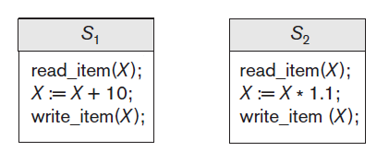
Characterizing Schedules Based on Serializability (cont’d.)
Result equivalent schedules
Produce the same final state of the database
May be accidental
Cannot be used alone to define equivalence of schedules
Two schedules that are result equivalent for the initial value of X = 100 but are not result equivalent in general

Slide 47
Characterizing Schedules Based on Serializability (cont’d.)
Conflict equivalence
Relative order of any two conflicting operations is the same in both schedules
If two conflicting operations are applied in different orders in two schedules, the effect can be different on the database or on the transactions in the schedule, and hence the schedules are not conflict equivalent.
Serializable schedules
Schedule S is serializable if it is conflict equivalent to some serial schedule S’.

Slide 48
Characterizing Schedules Based on Serializability (cont’d.)
Algorithm 20.1 can be used to test a schedule for conflict serializability.
The algorithm looks at only the read_item and write_item operations in a schedule to construct a precedence graph (or serialization graph), ➔
directed graph G = (N, E) that consists of a set of nodes N = {T1, T2, … , Tn } and a set of directed edges E = {e1, e2, … , em }.
There is one node in the graph for each transaction Ti in the schedule.
Each edge ei in the graph is of the form (Tj → Tk ), 1 ≤ j ≤ n, 1 ≤ k ≤ n, where Tj is the starting node of ei and Tk is the ending node of ei.
Such an edge from node Tj to node Tk is created by the algorithm if a pair of conflicting operations exist in Tj and Tk and the conflicting operation in Tj appears in the schedule before the conflicting operation in Tk

Slide 49
Characterizing Schedules Based on Serializability (cont’d.)
Algorithm 20.1 Testing conflict serializability of a schedule S
1. For each transaction Ti participating in schedule S, create a node labeled Ti in the precedence graph.
2. For each case in S where Tj executes a read_item(X) after Ti executes a write_item(X), create an edge (Ti → Tj) in the precedence graph.
3. For each case in S where Tj executes a write_item(X) after Ti executes a read_item(X), create an edge (Ti → Tj) in the precedence graph.
4. For each case in S where Tj executes a write_item(X) after Ti executes a write_item(X), create an edge (Ti → Tj) in the precedence graph.
5. The schedule S is serializable if and only if the precedence graph has no cycles

Slide 50
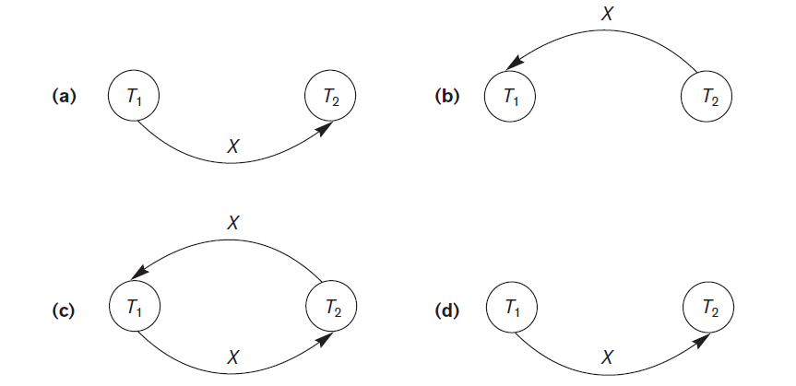
Characterizing Schedules Based on Serializability (cont’d.)
Figure 20.7 Constructing the precedence graphs for schedules A to D from Figure 20.5 to test for conflict serializability
(a) Precedence graph for serial schedule A
(b) Precedence graph for serial schedule B
(c) Precedence graph for schedule C (not serializable)
(d) Precedence graph for schedule D (serializable, equivalent to schedule A)

Slide 51
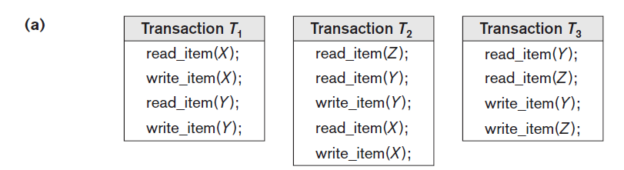
Characterizing Schedules Based on Serializability (cont’d.)
Another example of serializability testing. (a) The read and write operations of three transactions T1, T2, and T3.

Slide 52
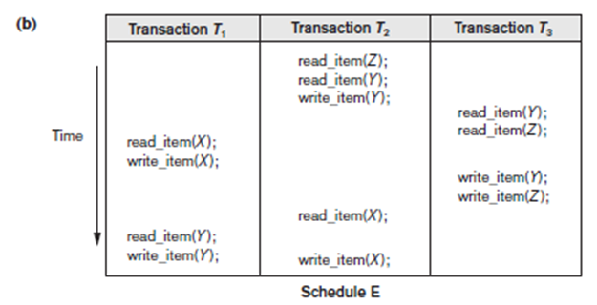
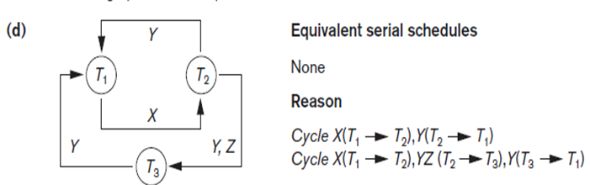
Characterizing Schedules Based on Serializability (cont’d.)
(b) Schedule E. (c) Schedule F.

Slide 53
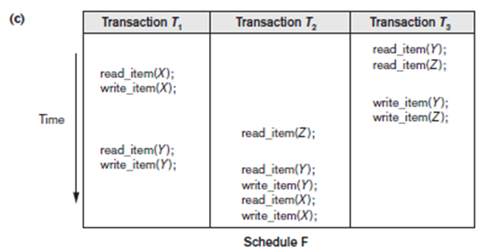
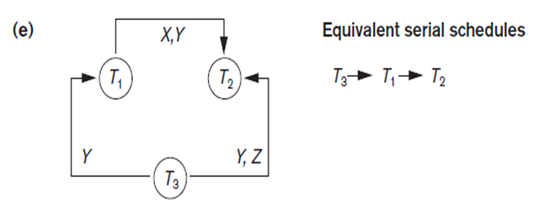
Characterizing Schedules Based on Serializability (cont’d.)

Slide 54
How Serializability is Used for Concurrency Control
Being serializable is different from being serial
A serial schedule represents inefficient processing
Serializable schedule gives benefit of concurrent execution
Without giving up any correctness
Difficult to test for serializability in practice
Factors such as system load, time of transaction submission, and process priority affect ordering of operations
DBMS enforces protocols
Set of rules to ensure serializability

Slide 55
View Equivalence and View Serializability
Two schedules S and S′ are said to be view equivalent if the following three conditions hold:
The same set of transactions participates in S and S′, and S and S′ include the same operations of those transactions.
For any operation ri(X) of Ti in S, if the value of X read by the operation has been written by an operation wj(X) of Tj (or if it is the original value of X before the schedule started), the same condition must hold for the value of X read by operation ri(X) of Ti in S′.
If the operation wk(Y) of Tk is the last operation to write item Y in S, then wk(Y) of Tk must also be the last operation to write item Y in S′.

Slide 56
View Equivalence and View Serializability
View equivalence of two schedules
As long as each read operation of a transaction reads the result of the same write operation in both schedules, the write operations of each transaction must produce the same results
Read operations said to see the same view in both schedules
View serializable schedule
View equivalent to a serial schedule

Slide 57
View Equivalence and View Serializability (cont’d.)
Conflict serializability similar to view serializability, if constrained write assumption (no blind writes) applies
This condition states that any write operation wi(X) in Ti is preceded by a ri(X) in Ti and that the value written by wi(X) in Ti depends only on the value of X read by ri(X).
Unconstrained write assumption
Value written by an operation can be independent of its old value
Less-stringent conditions than conflict serializability or view serializability

Slide 58
CHAPTER 21
Concurrency Control Techniques

Slide 59
Introduction
Concurrency control protocols
Set of rules to guarantee serializability
Two-phase locking protocols
Lock data items to prevent concurrent access
Timestamp
Unique identifier for each transaction
Multiversion currency control protocols
Use multiple versions of a data item
Validation or certification of a transaction

Slide 60
21.1 Two-Phase Locking Techniques for Concurrency Control
Lock
Variable associated with a data item describing the status for operations that can be applied
One lock for each item in the database
Binary locks
Two states (values)
Locked (1)
Item cannot be accessed
Unlocked (0)
Item can be accessed when requested

Slide 61
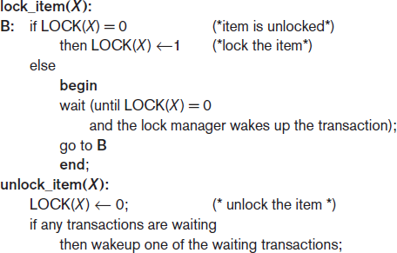
Two-Phase Locking Techniques for Concurrency Control (cont’d.)
Transaction requests access by issuing a lock_item(X) operation
Figure 21.1 Lock and unlock operations for binary locks

Slide 62
Two-Phase Locking Techniques for Concurrency Control (cont’d.)
Lock table specifies items that have locks
Lock manager subsystem
Keeps track of and controls access to locks
Rules enforced by lock manager module
At most one transaction can hold the lock on an item at a given time
Binary locking too restrictive for database items

Slide 63
Two-Phase Locking Techniques for Concurrency Control (cont’d.)
Shared/exclusive or read/write locks
Read operations on the same item are not conflicting
Must have an exclusive lock to write
Three locking operations
read_lock(X)
write_lock(X)
unlock(X)

Slide 64
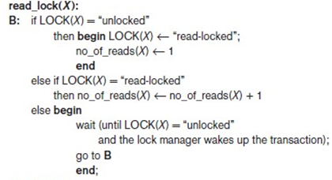
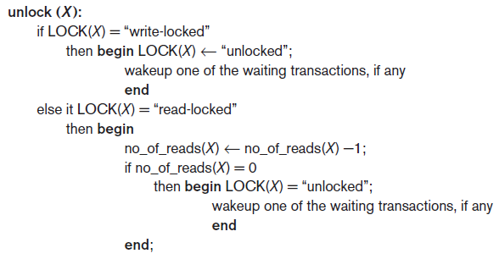
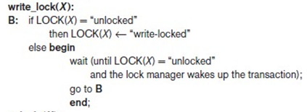
Figure 21.2 Locking and unlocking operations for two-mode (read/write, or shared/exclusive) locks

Slide 65
Two-Phase Locking Techniques for Concurrency Control (cont’d.)
Lock conversion
Transaction that already holds a lock allowed to convert the lock from one state to another
Upgrading
Issue a read_lock operation then a write_lock operation
Downgrading
Issue a read_lock operation after a write_lock operation

Slide 66
Guaranteeing Serializability by Two- Phase Locking
Two-phase locking protocol
All locking operations precede the first unlock operation in the transaction
Phases
Expanding (growing) phase
New locks can be acquired but none can be released
Lock conversion upgrades must be done during this phase
Shrinking phase
Existing locks can be released but none can be acquired
Downgrades must be done during this phase

Slide 67
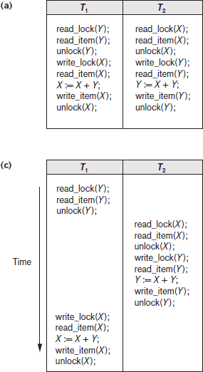
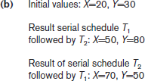
Result of schedule S:
X=50, Y=50
(nonserializable)
Figure 21.3 Transactions that do not obey two-phase locking (a) Two transactions T1 and T2 (b) Results of possible serial schedules of T1 and T2 (c) A nonserializable schedule S that uses locks

Slide 68
Guaranteeing Serializability by Two- Phase Locking
If every transaction in a schedule follows the two- phase locking protocol, schedule guaranteed to be serializable
Two-phase locking may limit the amount of concurrency that can occur in a schedule
Some serializable schedules will be prohibited by two-phase locking protocol

Slide 69
Variations of Two-Phase Locking
Basic 2PL
Technique described on previous slides
Conservative (static) 2PL
Requires a transaction to lock all the items it accesses before the transaction begins
Predeclare read-set and write-set
Deadlock-free protocol
Strict 2PL
Transaction does not release exclusive locks until after it commits or aborts

Slide 70
Variations of Two-Phase Locking 9cont’d)
Rigorous 2PL
Transaction does not release any locks until after it commits or aborts
Concurrency control subsystem responsible for generating read_lock and write_lock requests
Locking generally considered to have high overhead

Slide 71
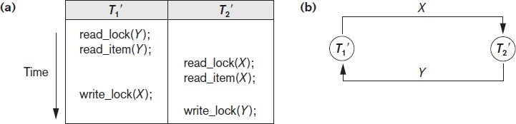
Dealing with Deadlock and Starvation
Deadlock
Occurs when each transaction T in a set is waiting for some item locked by some other transaction T’ and T’ is waiting in a cycle for T to release the lock
Both transactions stuck in a waiting queue
Figure 21.5 Illustrating the deadlock problem (a) A partial schedule of T1′ and T2′ that is in a state of deadlock (b) A wait-for graph for the partial schedule in (a)

Slide 72
Dealing with Deadlock and Starvation (cont’d.)
Deadlock prevention protocols
Every transaction locks all items it needs in advance
Ordering all items in the database
Transaction that needs several items will lock them in that order
Both approaches impractical
Protocols based on a timestamp
Wait-die
Wound-wait

Slide 73
Dealing with Deadlock and Starvation (cont’d.)
No waiting algorithm
If transaction is unable to obtain a lock, immediately aborted and restarted later
Cautious waiting algorithm
Deadlock-free
If Tj is not blocked (not waiting for some other locked item), then Ti is blocked and allowed to wait; otherwise abort Ti.
Deadlock detection
System checks to see if a state of deadlock exists
Wait-for graph

Slide 74
Dealing with Deadlock and Starvation (cont’d.)
Victim selection
Deciding which transaction to abort in case of deadlock
Timeouts
If system waits longer than a predefined time, it aborts the transaction
Starvation
Occurs if a transaction cannot proceed for an indefinite period of time while other transactions continue normally
Solution: first-come-first-served queue

Slide 75
21.2 Concurrency Control Based on Timestamp Ordering
Timestamp
Unique identifier assigned by the DBMS to identify a transaction
Assigned in the order submitted
Transaction start time
Concurrency control techniques based on timestamps do not use locks
Deadlocks cannot occur

Slide 76
Concurrency Control Based on Timestamp Ordering (cont’d.)
Generating timestamps
Counter incremented each time its value is assigned to a transaction
Current date/time value of the system clock
Ensure no two timestamps are generated during the same tick of the clock
General approach
Enforce equivalent serial order on the transactions based on their timestamps

Slide 77
The Timestamp Ordering Algorithm for Concurrency Control
Timestamp ordering (TO).
A schedule in which the transactions participate is then serializable, and the only equivalent serial schedule permitted has the transactions in order of their timestamp values

Slide 78
Concurrency Control Based on Timestamp Ordering (cont’d.)
Timestamp ordering (TO)
Allows interleaving of transaction operations
Must ensure timestamp order is followed for each pair of conflicting operations
Each database item assigned two timestamp values
read_TS(X):
read_TS(X) = TS(T), where T is the youngest transaction that has read X successfully.
write_TS(X)
write_TS(X) = TS(T), where T is the youngest transaction that has written X successfully.

Slide 79
Concurrency Control Based on Timestamp Ordering (cont’d.)
Basic TO algorithm
If conflicting operations detected, later operation rejected by aborting transaction that issued it
Schedules produced guaranteed to be conflict serializable
Starvation may occur
Strict TO algorithm
Ensures schedules are both strict and conflict serializable

Slide 80
Concurrency Control Based on Timestamp Ordering (cont’d.)
Thomas’s write rule
Modification of basic TO algorithm
Does not enforce conflict serializability
Rejects fewer write operations by modifying checks for write_item(X) operation

Slide 81
Concurrency Control Based on Timestamp Ordering (cont’d.)
Thomas’s write rule
If read_TS(X) > TS(T), then abort and roll back T and reject the operation.
If write_TS(X) > TS(T), then do not execute the write operation but continue processing
If neither the condition in part (1) nor the condition in part (2) occurs, then execute the write_item(X) operation of T and set write_TS(X) to TS(T)

Slide 82
21.3 Multiversion Concurrency Control Techniques
Several versions of an item are kept by a system
Some read operations that would be rejected in other techniques can be accepted by reading an older version of the item
Maintains serializability
More storage is needed
Multiversion currency control scheme types
Based on timestamp ordering
Based on two-phase locking
Validation and snapshot isolation techniques

Slide 83
Multiversion Concurrency Control Techniques (cont’d.)
Multiversion technique based on timestamp ordering
Two timestamps associated with each version are kept
read_TS(X_{i})
write_TS(X_{i})

Slide 84
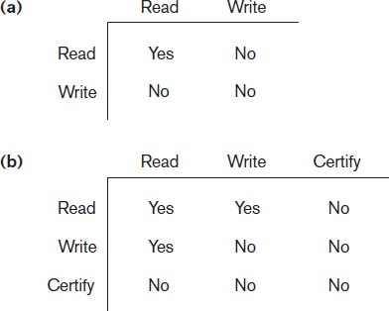
Multiversion Concurrency Control Techniques (cont’d.)
Multiversion two-phase locking using certify locks
Three locking modes: read, write, and certify
Figure 21.6 Lock compatibility tables (a) Lock compatibility table for read/write locking scheme (b) Lock compatibility table for read/write/certify locking scheme

Slide 85
CHAPTER 22
Database Recovery Techniques

Slide 86
Introduction
Recovery algorithms
Recovery concepts
Write-ahead logging
In-place versus shadow updates
Rollback
Deferred update
Immediate update
Certain recovery techniques best used with specific concurrency control methods

Slide 87
22.1 Recovery Concepts
Recovery process restores database to most recent consistent state before time of failure
Information kept in system log
Typical recovery strategies
Restore backed-up copy of database
Best in cases of extensive damage
Identify any changes that may cause inconsistency
Best in cases of noncatastrophic failure
Some operations may require redo

Slide 88
Recovery Concepts –Categorization of Recovery Algorithms
Deferred update techniques
Do not physically update the database until after transaction commits
Undo is not needed; redo may be needed
also known as the NO-UNDO/REDO algorithm.
Immediate update techniques
Database may be updated by some operations of a transaction before it reaches commit point
Operations also recorded in log
Recovery still possible
This technique, is known as the UNDO/REDO algorithm

Slide 89
Recovery Concepts –Categorization of Recovery Algorithms
Undo and redo operations required to be idempotent
Entire recovery process should be idempotent-that is, executing an operation multiple times is equivalent to executing it just once.
Caching (buffering) of disk blocks
DBMS cache: a collection of in-memory buffers
This can be a table of <Disk_page_address, Buffer_location, … > entries
Cache directory keeps track of which database items are in the buffers

Slide 90
Recovery Concepts (cont’d.)
Cache buffers replaced (flushed) to make space for new items
Dirty bit associated with each buffer in the cache
Indicates whether the buffer has been modified (initial value 0; on modification of the buffer, it is set to 1)
Contents written back to disk before flush if dirty bit equals one
Pin-unpin bit
Page is pinned if it cannot be written back to disk yet

Slide 91
Recovery Concepts (cont’d.)
Main strategies
In-place updating
Writes the buffer to the same original disk location
Overwrites old values of any changed data items
Shadowing
Writes an updated buffer at a different disk location, to maintain multiple versions of data items
Not typically used in practice
Before-image (BFIM): old value of data item
After-image (AFIM): new value of data item

Slide 92
Write-Ahead Logging, Steal/No-Steal, and Force/No-Force
Write-ahead logging
Ensure the before-image (BFIM) is recorded
Appropriate log entry flushed to disk, before the BFIM is overwritten with the AFIM in the database on disk.
Necessary for UNDO operation if needed
UNDO-type log entries- includes the old entry to undo
REDO-type log entries- includes the new entry to redo

Slide 93
Write-Ahead Logging, Steal/No-Steal, and Force/No-Force
Steal/no-steal and force/no-force
Specify rules that govern when a page from the database cache can be written to disk
If a cache buffer page updated by a transaction cannot be written to disk before the transaction commits, the recovery method is called a no-steal approach.
if the recovery protocol allows writing an updated buffer before the transaction commits, it is called steal.
The no-steal rule means that UNDO will never be needed during recovery, since a committed transaction will not have any of its updates on disk before it commits

Slide 94
Recovery Concepts (cont’d.)
Force approach
All pages updated by a transaction are immediately written to disk before the transaction commits
Otherwise, no-force
Typical database systems employ a steal/no- force strategy
Avoids need for very large buffer space
Reduces disk I/O operations for heavily updated pages

Slide 95
Recovery Concepts (cont’d.)
Write-ahead logging (WAL) protocol for recovery algorithm requiring both UNDO and REDO
BFIM of an item cannot be overwritten by its after image until all UNDO-type log entries have been force-written to disk
Commit operation of a transaction cannot be completed until all REDO-type and UNDO-type log records for that transaction have been force-written to disk

Slide 96
Checkpoints in the System Log and Fuzzy Checkpointing (22.1.4)
Taking a checkpoint
Suspend execution of all transactions temporarily
Force-write all main memory buffers that have been modified to disk
Write a checkpoint record to the log, and force- write the log to the disk
Resume executing transactions
DBMS recovery manager decides on checkpoint interval

Slide 97
Checkpoints in the System Log and Fuzzy Checkpointing (cont’d.)
Fuzzy checkpointing
System can resume transaction processing after a begin_checkpoint record is written to the log
Previous checkpoint record maintained until end_checkpoint record is written

Slide 98
Transaction Rollback (22.1.5)
Transaction failure after update but before commit
Necessary to roll back the transaction
Old data values restored using undo-type log entries
Cascading rollback
If transaction T is rolled back, any transaction S that has read value of item written by T must also be rolled back
Almost all recovery mechanisms designed to avoid this

Slide 99
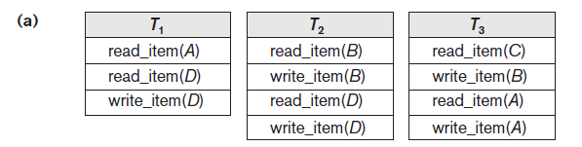
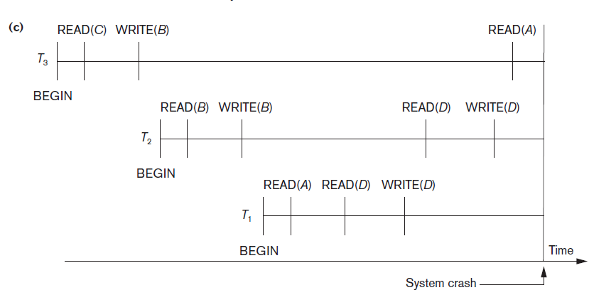
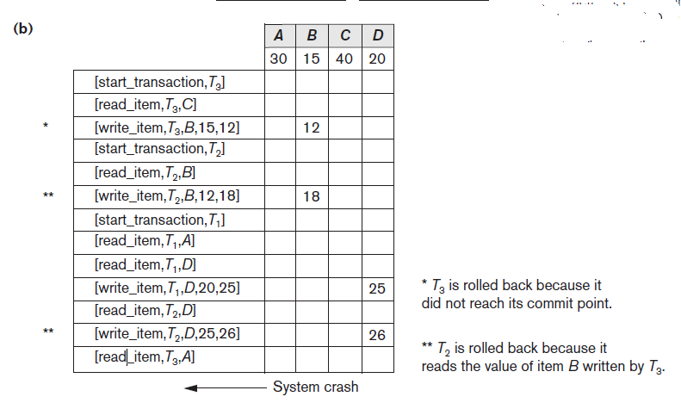
Figure 22.1 Illustrating cascading rollback (a process that never occurs in strict or cascadeless schedules) (a) The read and write operations of three transactions (b) System log at point of crash (c) Operations before the crash

Slide 100
Transactions that Do Not Affect the Database (22.1.6)
Example actions: generating and printing messages and reports
If transaction fails before completion, may not want user to get these reports
Reports should be generated only after transaction reaches commit point
Commands that generate reports issued as batch jobs executed only after transaction reaches commit point
Batch jobs canceled if transaction fails

Slide 101
22.2 NO-UNDO/REDO Recovery Based on Deferred Update
Deferred update concept
Postpone updates to the database on disk until the transaction completes successfully and reaches its commit point
Redo-type log entries are needed
Undo-type log entries not necessary
Can only be used for short transactions and transactions that change few items
Buffer space an issue with longer transactions

Slide 102
NO-UNDO/REDO Recovery Based on Deferred Update (cont’d.)
Deferred update protocol
Transaction cannot change the database on disk until it reaches its commit point
All buffers changed by the transaction must be pinned until the transaction commits (no-steal policy)
Transaction does not reach its commit point until all its REDO-type log entries are recorded in log and log buffer is force-written to disk

Slide 103
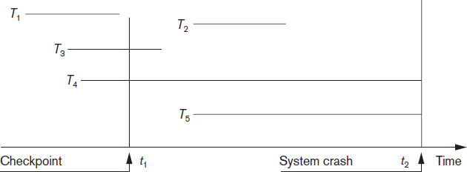
NO-UNDO/REDO Recovery Based on Deferred Update (cont’d.)
Figure 22.2 An example of a recovery timeline to illustrate the effect of checkpointing

Slide 104
22.3 Recovery Techniques Based on Immediate Update
Database can be updated immediately
No need to wait for transaction to reach commit point
Not a requirement that every update be immediate
UNDO-type log entries must be stored
Recovery algorithms
UNDO/NO-REDO (steal/force strategy)
UNDO/REDO (steal/no-force strategy)

Slide 105
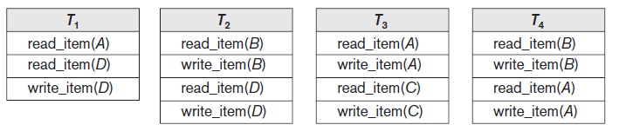
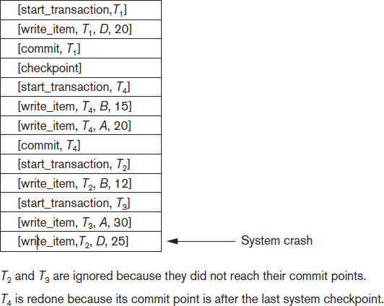
Figure 22.3 An example of recovery using deferred update with concurrent transactions
(a) The READ and
WRITE operations of four transactions (b) System log at the point of crash

Slide 106
22.4 Shadow Paging
No log required in a single-user environment
Log may be needed in a multiuser environment for the concurrency control method
Shadow paging considers disk to be made of n
fixed-size disk pages
Directory with n entries is constructed
When transaction begins executing, directory copied into shadow directory to save while current directory is being used
Shadow directory is never modified

Slide 107
Shadow Paging
New copy of the modified page created and stored elsewhere
Current directory modified to point to new disk block
Shadow directory still points to old disk block
Failure recovery
Discard current directory
Free modified database pages
NO-UNDO/NO-REDO technique

Slide 108
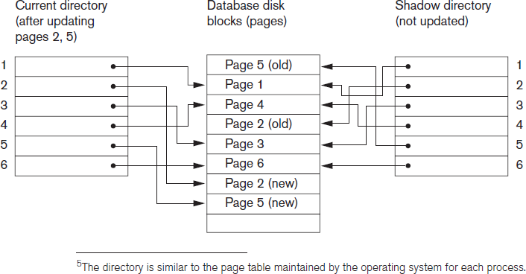
Shadow Paging (cont’d.)
Figure 22.4 An example of shadow paging

Slide 109
Thank YOU BEST OF LUCK!!!

